Slide 1
MOVIE RECOMMENDATION SYSTEM
Done by,
P.ANANDHAN
Reg No. : 912321104002
SACS MAVMM ENGINEERING COLLEGE
MADURAI

Slide 2
Project overview:
Problem statement
Proposed system/solution
System development approach
Algorithm and deployment
Result
conclusion

Slide 3
Problem statement
Design and implement a movie recommendation system that provides personalized movie recommendations to users based on their preferences, historical movie ratings, and viewing habits. The system should utilize machine learning algorithms to analyze user data and recommend movies that are likely to be enjoyed by the user. The goal is to enhance user experience by offering relevant and engaging movie suggestions, thereby increasing user satisfaction and retention on the platform.In today's digital era, the demand for personalized experiences is growing rapidly across various domains, including social media, e-commerce, and entertainment.The aim of this project is to develop a face recommendation system that can intelligently suggest relevant faces to users based on their preferences, interests, and social connections.

Slide 4
Proposed System/Solution
1. Data Collection and Preprocessing: - Gather a comprehensive dataset including movie details (title, genre, release year, etc.) and user interactions (ratings, reviews, watch history). - Preprocess the data to handle missing values, normalize ratings, and extract relevant features like genres, actors, directors, etc.
2. Exploratory Data Analysis (EDA): - Conduct EDA to gain insights into user preferences, popular genres, highly-rated movies, and other patterns within the dataset. - Use visualization techniques to understand data distributions, correlations, and user behavior trends.
3. Algorithm Selection: - Implement collaborative filtering techniques such as user-based, item-based, or matrix factorization methods to generate recommendations.
- Explore content-based filtering to recommend movies based on similarities in features like genres, actors, directors, and plot summaries. - Consider hybrid approaches combining collaborative and content-based filtering for improved recommendation accuracy.
4. Model Training and Evaluation:- Split the dataset into training and testing sets for model training and evaluation purposes. - Train recommendation models using appropriate algorithms and hyperparameter tuning techniques.
- Evaluate model performance using metrics like Mean Absolute Error (MAE), Root Mean Squared Error (RMSE), precision, recall, and F1-score.

Slide 5
Proposed system/solution(Contd…)
5. User Interface Development: - Develop a user-friendly interface accessible via web or mobile platforms where users can input their preferences, view recommended movies, and provide feedback. - Incorporate features like search functionality, filtering options (by genre, release year, ratings), and personalized recommendation lists for each user.
6. Real-time Updates and Feedback Loop: - Implement a feedback loop to collect user interactions, ratings, and feedback on recommended movies. - Utilize this data to continuously update and improve the recommendation models, adapting to evolving user preferences and trends.
7. Scalability and Performance: - Design the system architecture to handle scalability, ensuring efficient processing of large datasets and concurrent user requests. - Utilize caching mechanisms, distributed computing frameworks (e.g., Apache Spark), and cloud infrastructure for improved performance and scalability.

Slide 6
System development approach
Requirement Gathering and Analysis:- Define the objectives and goals of the movie recommendation system.- Gather requirements by conducting stakeholder interviews, surveys, and analyzing user preferences and expectations.
Data Collection and Preparation: - Collect a diverse dataset containing movie metadata (title, genre, cast, release year) and user interactions (ratings, reviews, watch history). - Preprocess the data by handling missing values, encoding categorical variables, and normalizing ratings.
Exploratory Data Analysis (EDA):- Perform EDA to understand data distributions, correlations, and user behavior patterns. - Use visualization techniques to identify popular genres, highly-rated movies, and user preferences.
Model Selection and Development:- Select appropriate recommendation algorithms based on the dataset characteristics and requirements (e.g., collaborative filtering, content-based filtering, hybrid approaches). -
Develop and train recommendation models using machine learning libraries (e.g., scikit-learn, TensorFlow, PyTorch) and techniques such as matrix factorization or deep learning.

Slide 7
.
System development approach(Contd…)
5. Model Evaluation and Validation: - Split the dataset into training and testing sets to evaluate model performance. - Use evaluation metrics like Mean Absolute Error (MAE), Root Mean Squared Error (RMSE), precision, recall, and F1-score to assess recommendation accuracy.
6. User Interface Design and Development: - Design an intuitive and user-friendly interface for the recommendation system (web or mobile app). - Include features like search functionality, personalized recommendation lists, user feedback mechanisms, and social sharing options.
7. Integration and Testing:- Integrate recommendation models with the user interface and backend services. - Conduct thorough testing including unit testing, integration testing, and user acceptance testing to ensure system functionality, performance, and usability.
By following this systematic approach, the movie recommendation system can be effectively developed, validated, and deployed to deliver personalized and engaging movie suggestions to users, ultimately enhancing their overall experience and satisfaction.

Slide 8
Algorithm and deployment:
As the online streaming industry expands, the movie recommender system is becoming increasingly important to individual users & production companies alike.
systems are employed with the intention of enhancing a user's movie watching experience by providing them with the most suitable options
Filtration strategies for recommendation systems can be broadly classified into two types: content-based filtering & collaborative filtering.
1. Content-Based Filtering
Content-based filtering utilizes the attributes & metadata of a movie to generate recommendations that share similar properties.
For instance, the analysis of the genre, director, actors, & plot of a movie recommendation system dataset would be leveraged for suggesting movies of the same genre, with similar actors or themes.
The primary advantage of content-based filtering is that it can produce reliable recommendations, even with the absence of user data
. However, the quality of content-based filtering can be affected if a movie's metadata is incorrectly labeled, misleading or limited in scope.

Slide 9
Algorithm and deployment (contd…)
2. Collaborative Filtering Collaborative filtering, on the other hand, depends on the patterns of interaction between users & their preferences.
The movie recommendation system dataset is used in this strategy to analyze the history of a user’s preferences & suggest movies that other users with similar interests enjoy. The significant merit of collaborative filtering is that it can eliminate the effects of limited metadata & low audience size.
But a considerable challenge of collaborative filtering is to overcome new user (cold start) & sparsity problems that arise from a lack of user ratings.

Slide 10
Algorithm and deployment (contd…)
DEPLOYMENT:
Deploying a recommendation system involves several steps to ensure its functionality, scalability, and reliability. Here's a high-level overview of the deployment process for a recommendation system:
1. Preparation and Testing:
- Ensure that your recommendation model is trained and validated on relevant data.
- Test the model thoroughly to ensure its accuracy, performance, and efficiency.
2. Selecting Deployment Infrastructure:
- Choose an appropriate deployment environment based on factors like scalability, availability, and cost. Options include cloud platforms like AWS, Azure, or Google Cloud, or on-premises solutions.
3. Setting up Infrastructure:
- Provision necessary infrastructure components such as servers, databases, and networking resources.
- Configure the environment to handle expected load and traffic spikes.

Slide 11
Algorithm and deployment(Contd…)
4. Model Deployment:
- Deploy the recommendation model to the chosen infrastructure. This might involve setting up API endpoints for serving predictions or integrating the model into your application directly.
- Ensure that the deployed model is scalable and can handle concurrent requests efficiently.
5. Data Pipeline Deployment:
- Set up data pipelines to continuously feed new data into the recommendation system.
- Implement mechanisms for data preprocessing, feature extraction, and model updates as needed.
6. Monitoring and Logging:
- Implement monitoring tools to track the performance and health of your recommendation system in real-time.
- Set up logging to record relevant information such as errors, user interactions, and system metrics.
By following these steps, you can effectively deploy a recommendation system that meets the needs of your users while ensuring reliability, scalability, and security.

Slide 12
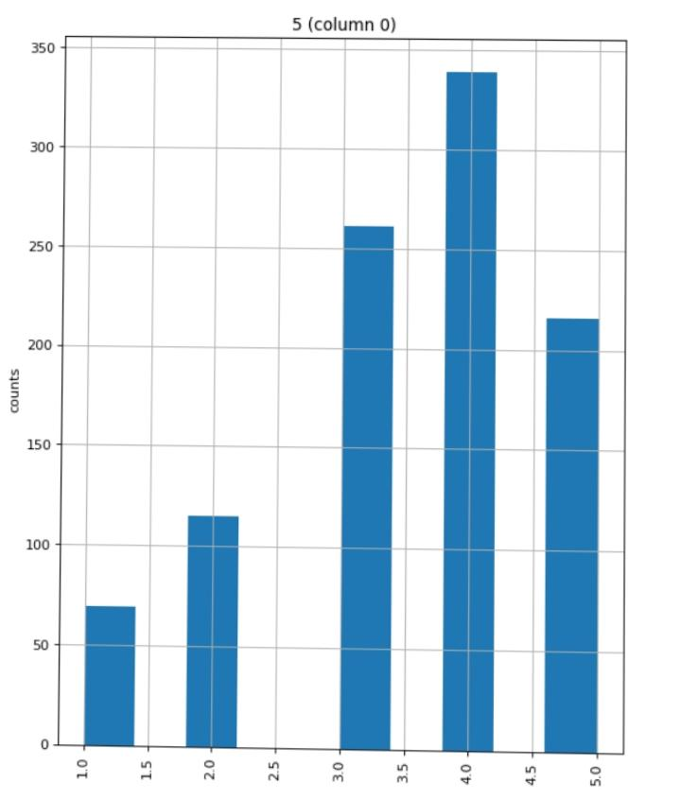
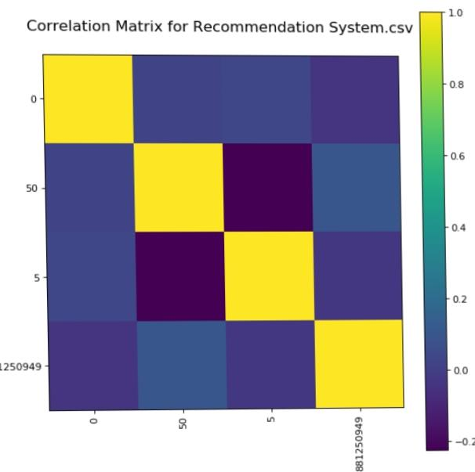
Result
Fig. : Distributed Graph

Slide 13
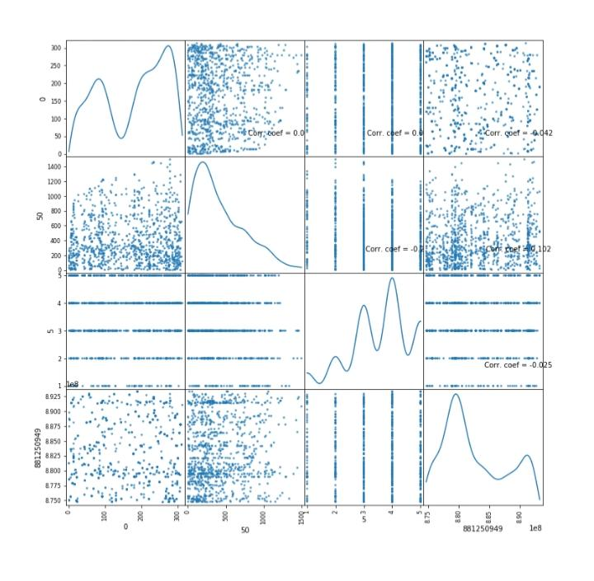
Fig. : Scatter plot

Slide 14
.
Reference
http://numpy.org
http://pandas.org
http://matplotlib.org
http://standardScaler.org
http:// goggle colab.in
Dataset link:
https://www.kaggle.com/datasets/zeeshanmulla/recommendation-system-movie/code

Slide 15
conclusion
A movie recommendation system serves as a valuable tool for users seeking personalized suggestions based on their preferences and viewing history. By leveraging advanced algorithms such as collaborative filtering, content-based filtering, or hybrid approaches, these systems can analyze vast amounts of data to generate accurate and relevant recommendations.Additionally, incorporating features like user ratings, genre preferences, and contextual information enhances the system’s effectiveness. Ultimately, a well-designed movie recommendation system not only enhances user experience but also drives user engagement and satisfaction, contributing to the success of streaming platforms and online movie services.

Slide 16
Thank you!..

